Slide 1

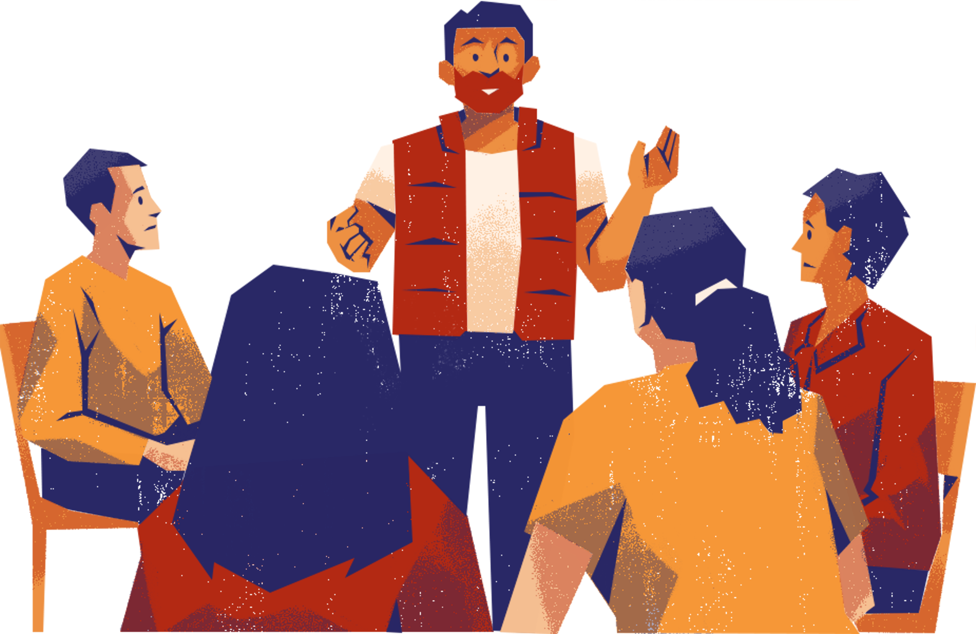



Module 1
IDEA Concepts & Frameworks

Slide 2
Exercise
Reflecting on Diversity, Inclusion and Exclusion
  One corner of the room is Diversity, another corner is Inclusion, and another Exclusion
  A statement will be shown on the slide. If you are able, walk over to the concept which you think best matches this statement. So, do you think the statement is about Diversity, Inclusion or Exclusion?
  Once everyone is in position, we will discuss the different interpretations (max. 15 min. per statement)
  There is no right or wrong answer!
Notes:
Explain the exercise according to the instructions on the screen and the manual.
Important to mention: There is no right or wrong answer, the point is to discuss how these statements can be interpreted differently and how these seemingly simple concepts can have different meanings from different perspectives.

Slide 3
Statement 1
Our university/faculty should be a reflection of society
Notes:
As a facilitator, ensure that:
- Several people from every 'group' (Diversity, Inclusion and Excluson) get to speak and explain why they chose to stand there. Allow other participants to respond.
- Make sure participants stay on topic: the point is not for participants to go into why they agree or disagree with the statement, but why they think it relates to diversity, inclusion or exclusion. The point is to start to give different definitions/perspectives to these concepts.
- Take max. 15 min for discussion of each statement

Slide 4
Statement 2
I don’t see difference, because everyone is equal to me
Notes:
'Difference' here refers to aspects such as color/race, gender, class, disability, etc.
As a facilitator, ensure that:
- Several people from every 'group' (Diversity, Inclusion and Excluson) get to speak and explain why they chose to stand there. Allow other participants to respond.
- Make sure participants stay on topic: the point is not for participants to go into why they agree or disagree with the statement, but why they think it relates to diversity, inclusion or exclusion. The point is to start to give different definitions/perspectives to these concepts.
- Take max. 15 min for discussion of each statement

Slide 5
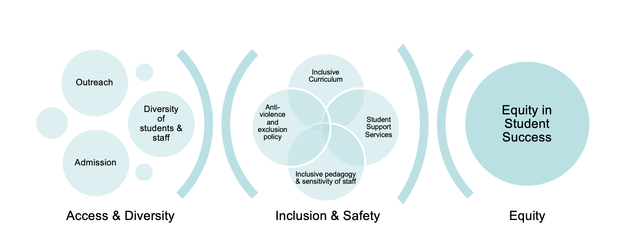
IDEA concepts
Notes:
Access and Diversity focus on the front door—who gets the opportunity to enter the university.
• Access is about removing barriers so that people from all backgrounds—regardless of income, race, disability, gender, or other identity factors—can apply and be admitted.
• Diversity refers to the presence of a wide range of people with different identities and experiences within the university community.
To have a truly diverse university, access must be equitable. That’s why outreach, recruitment, admissions, and hiring practices all play a key role in shaping both access and diversity.
Inclusion is about what happens after people are in. It asks: Do all students and staff feel respected, valued, and supported to succeed?
• Inclusion ensures that people don’t just enter the institution but also feel a sense of belonging and have equal opportunities to participate and thrive.
• Safety, in some contexts, is also part of inclusion. It refers to creating environments free from harm, discrimination, or exclusion.
This includes things like inclusive curricula, culturally responsive teaching, support services, and policies that protect against discrimination and harassment.
Equity goes a step further. It recognizes that not everyone starts from the same place, and so simply treating everyone the same is not enough.
• Equity means recognizing that the system is inequitable and giving each person what they need to succeed—whether that's academic support, accessible resources, or adjustments to ensure fair treatment and outcomes.
• Besides providing support to function in an inequitable system, equity can also be about changing the system to take away the inequities in the first place. The goal is to address systemic inequalities that lead to different outcomes for different groups of students or staff.

Slide 6
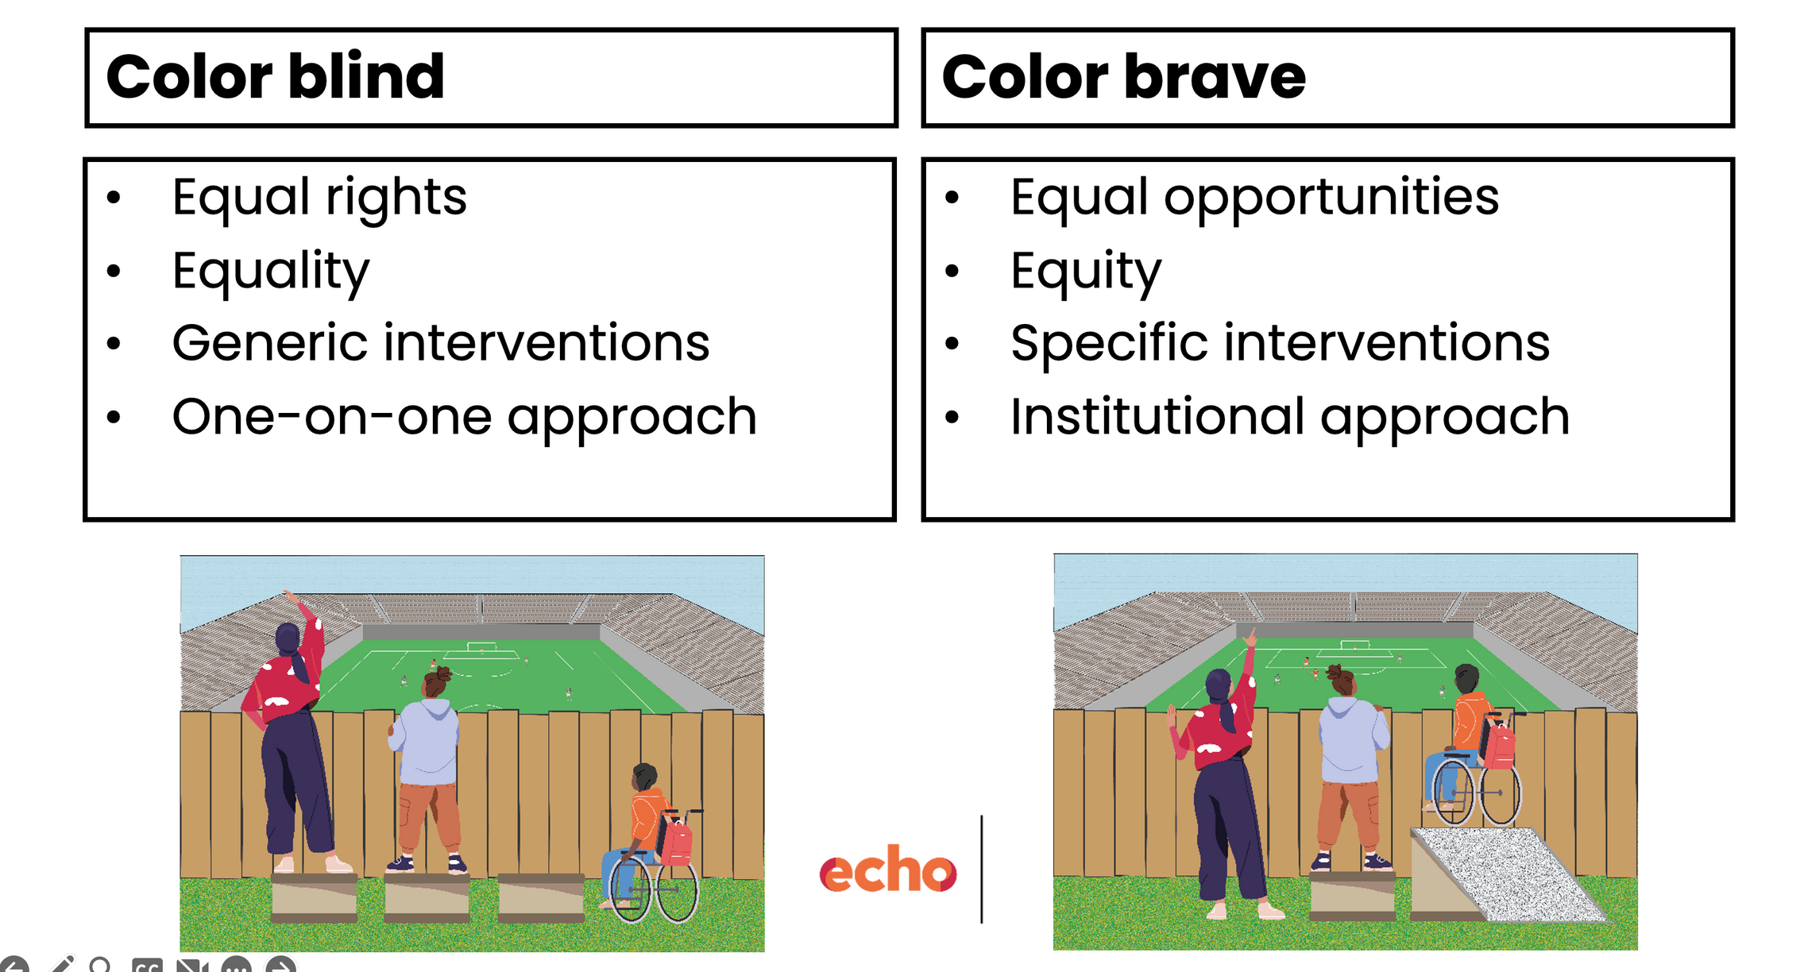
Notes:
An equity-minded approach can also be denoted as a color brave approach, as opposed to a color blind approach.
A colorbrave approach acknowledges that the playing field is not level and that specific interventions for specific groups are needed to create equal opportunities for all. The color brave approach views inequity as an institutional problem.
A color blind approach does not acknowledge these inequities inherent in the system and applies the same, generic approach to everyone, based on the principles of equality rather than equity. The color blind approach views inequity as an individualized problem.

Slide 7
Common dimensions of diversity in IDEA policy
Dimension in IDEA policy | Typical target group
Gender | Women, sometimes men (in case of underrepresentation in specific field, e.g. care work)
Gender identity and sexual orientation | LGBTQIA+
Ethnicity | Ethnic minorities, migrants, people of color, etc.
Disability | Physically and mentally disabled; neurodivergent people
Socio-economic | Low SES; first generation students
Other | Age, religion, rural/urban, etc.
Notes:
Important to mention: These are not necessarily the only or 'correct' ways to categorize these dimensions. For example, gender is not necessarily always approached as binary in policy with LGBTQIA+ as a separate category. But the reason that these dimensions are often categorised in this particular way in policy is due to their historical origins. The reason that IDEA policy exists today is due to various social movements pushing for equality of certain groups, such as women’s movements, gay/LGBTQI+ liberation movements, anti-racism movements, disability rights movements, class struggle, etc.

Slide 8
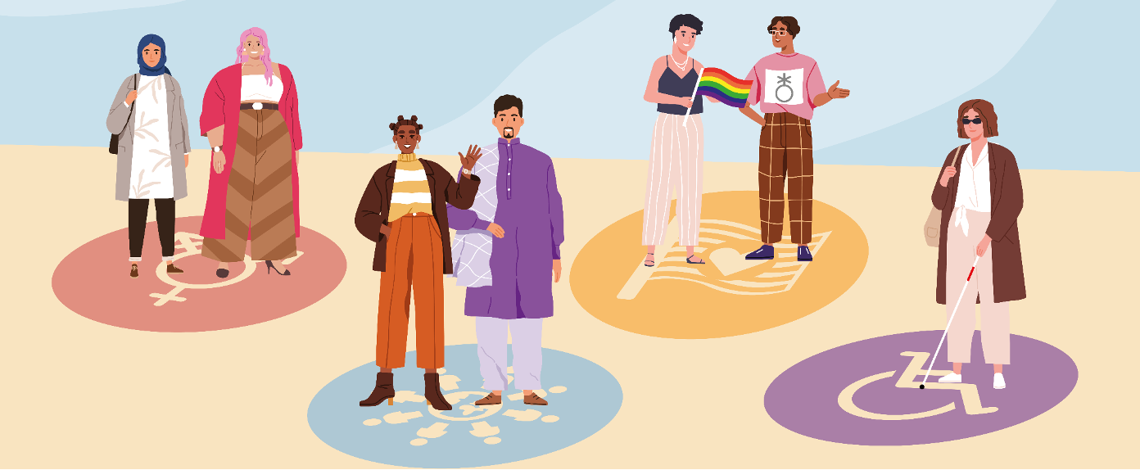
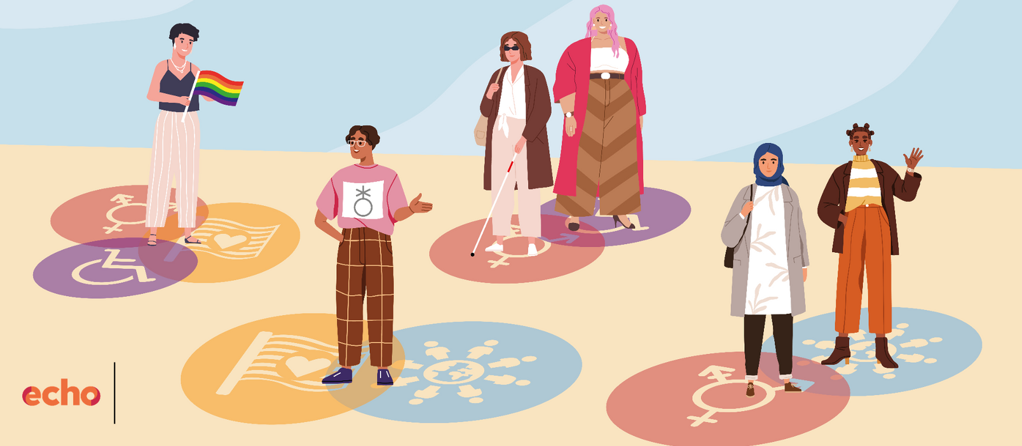
<- One-dimensional view of diversity
Intersectional view of diversity ->
Notes:
However, by categorizing difference we don't always acknowledge that there is overlap between these groups. No one is just one dimension. This slide shows the difference between looking at diversity in a simple way and looking at it through an intersectional lens.
On the top, you see a one-dimensional view—maybe focusing on just one aspect, like gender or ethnicity. This kind of approach can miss a lot. It treats people as if they all have the same experience just because they share one identity.
But on the bottom, you see an intersectional view. This recognises that people don’t fit into neat boxes. Someone can be, for example, a queer Muslim woman with a disability—and each of those aspects interacts with the others in shaping her experience.
So, an intersectional view gives us a more complete and realistic picture. It helps us understand people’s actual needs better, and it shows why inclusion work has to be nuanced—not just about checking boxes, but really listening to the complexity of people’s lives.

Slide 9
Intersectionality
  Layered identity → multiple forms of exclusion
  Specific combination of identity markers → specific experience of exclusion
  Societal context → individual experience is shaped by structural problems in society
Notes:
Intersectionality, a term coined by Kimberle Crenshaw (1989) is really about how different parts of who we are—like our background, gender, skin colour, religion, disability, or sexuality—come together and shape our experiences in life.
We all have layered identities, and sometimes these layers can lead to overlapping challenges. For example, someone might face barriers not just because they're a woman, but also because they're a woman with a migrant background. That specific combination creates a unique experience.
It’s important to remember that these experiences don’t happen in a vacuum. They’re shaped by bigger things going on in society, like racism, sexism, or discrimination in education or the workplace. These aren’t just personal problems—they’re structural issues that affect how people are treated.
So intersectionality helps us see the full picture. It reminds us that people’s experiences of exclusion or unfairness are complex, and to make real change, we have to take all of these layers into account.

