Slide 1





Module 5
Formulating next steps
Towards a more inclusive campus

Slide 2
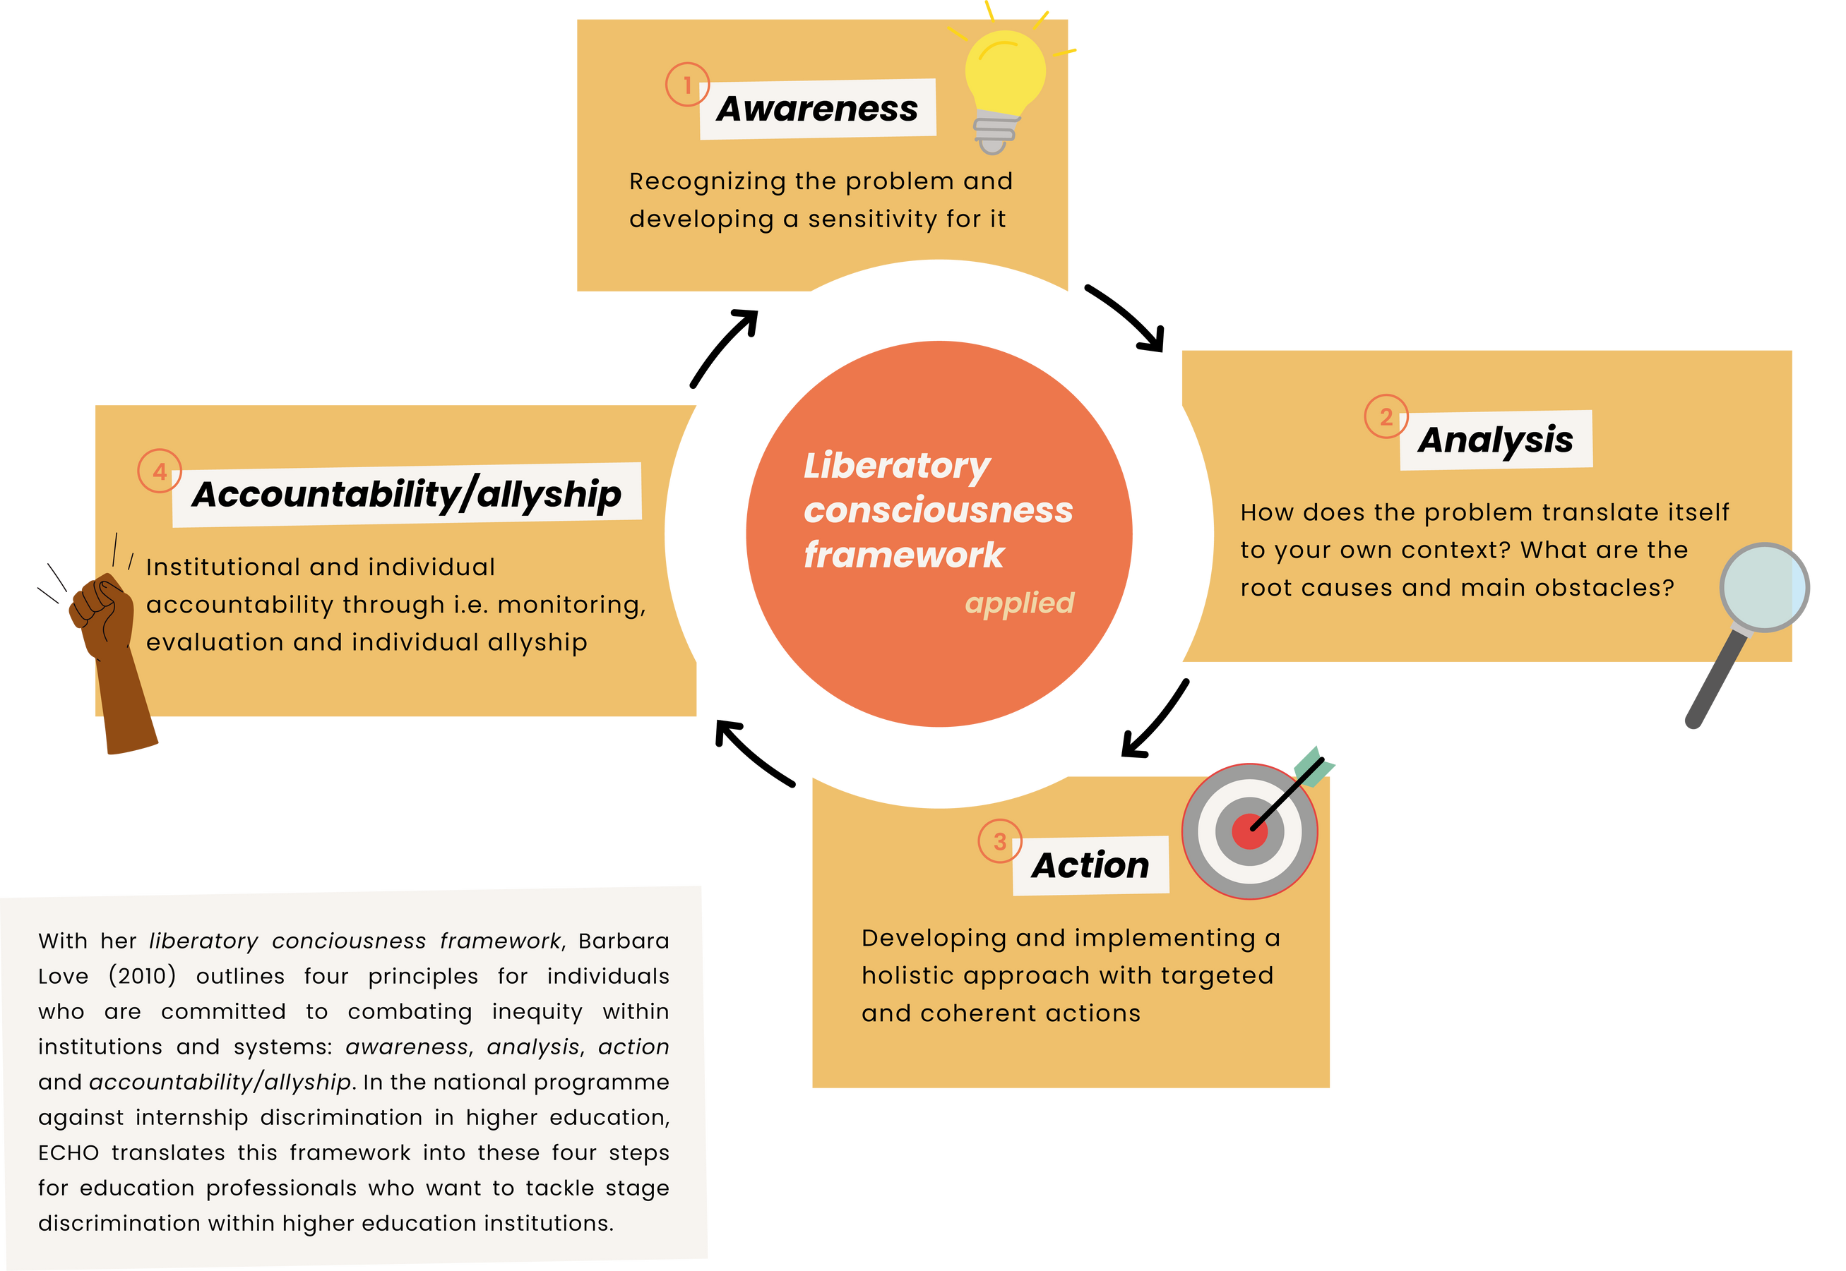
In this context, we can translate her framework to these guiding steps to contribute to targeted, institutional change.
Notes:
Start by briefly introducing the liberatory consciousness framework using the information and slides in this module, emphasizing that it is essential to have an awareness of IDEA and to analyze our context before jumping into actions and strategy.
In her framework, Love outlines four principles for individuals committed to challenge inequity within institutions and systems: awareness, analysis, action and accountability/allyship. These principles aim to foster a mindset and practice that supports justice, equity, and liberation for all.
In this specific context, we translate these principles to guide our process of formulating next steps as follows:
Awareness: Recognizing and understanding the existence of inequities and how it operates at individual, institutional, and systemic levels is our starting point. This involves continuous self-reflection and learning about privilege, power, and marginalization. This is what the previous modules aim to contribute to.
Analysis: This involves developing a deeper understanding of the causes and mechanisms of oppression. To analyze means to connect personal experiences to broader social structures and histories, and identifying patterns and systems of injustice. In this context, we aim to analyze how inequities translate to and manifest in your institution. It is essential to conduct this analysis, as simply implementing good practices from other institutions can lead to ineffective interventions that do not fit your institutional context.
Action: Action means taking intentional steps to challenge and disrupt inequities. This includes speaking out, organizing, supporting others, and creating change through daily behaviors and larger movements. In this context, it can also mean designing and implementing IDEA at your institution.
Accountability/allyship: This involves being responsible for one’s role in sustaining or dismantling oppression. It involves listening, learning from marginalized communities, building trust, and acting in solidarity with integrity and humility. In this context, it can also relate to monitoring, evaluating and being accountable for implemented IDEA-initiatives.
As this is a closing workshop to develop the next steps for IDEA at your institution, we focus on the principles Analysis and Action in this module’s activity.

Slide 3
Identifying opportunities
What specific IDEA-related problems/opportunities at our institution have we identified over the course of these sessions?
Notes:
Either as a central discussion or first in groups, take some time to make a (visual) overview of the key acute problems at your institution related to IDEA. Many of these have most likely already come up in discussions if this module is done at the end of a longer process of capacity building. Ask participants to reflect once more on what has been discussed and what else they have identified. They can for example discuss this in groups and write down their ideas on post-its to make a collective overview of the key problems/opportunities.

Slide 4
Formulating next steps
1. Brainstorm individually (3min)
    Come up with max. 4 interventions/ideas/actions that could potentially tackle the problems we have identified
2. Compare in pairs (10 min)
    Compare your lists and narrow down to 4 interventions combined
3. Synthesize in groups (30-40 min)
    Compare your lists, narrow down & prioritize!
    Who and what is needed to take the first next steps?
4. Present action plan to other participants
Notes:
Once a overview of the problems at hand have been created, ask the participants to think of a targeted approach for next steps related to IDEA at their institution. You can use the think-pair-share method on the slide for equal participation.

