Slide 1





Module 4
Inclusive Curriculum & Pedagogy
Inspiration and considerations

Slide 2
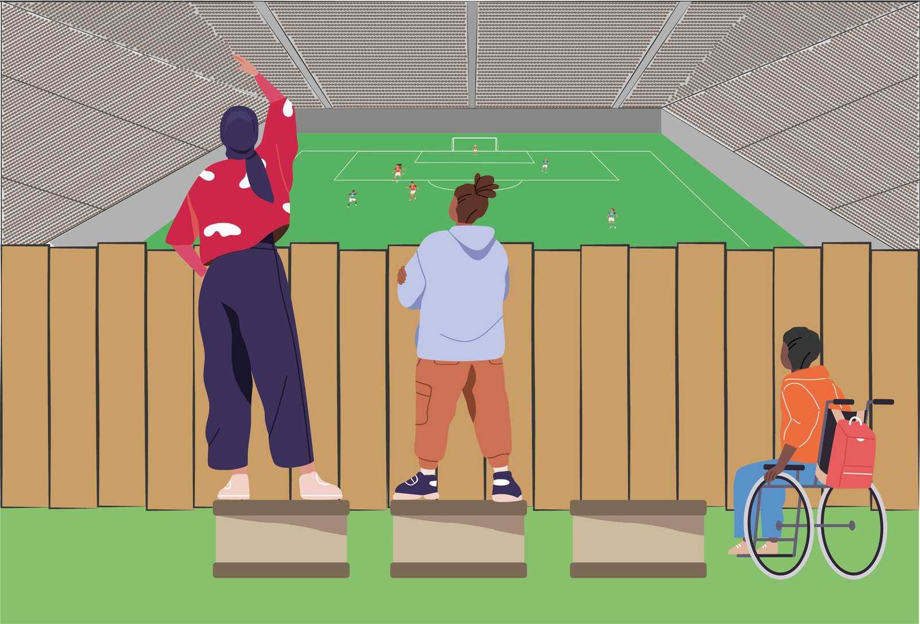
Approaches
Generic approach
  Same approach for all students (equality rather than equity)
  Students who do not fit the norm cannot fully participate and realize potential
  Underachievement is individualized
Notes:
From the many different frameworks and literature available, four broad approaches to inclusive pedagogy can be discerned.
Generic approaches: Guided by the principles of fairness and equality (rather than equity), generic approaches apply the same pedagogical approach to all students. It assumes a single standard fits everyone, which often marginalizes students who deviate from the dominant norm. As a result, it tends to individualize underachievement, overlooking systemic barriers and excluding those whose learning needs and identities differ.

Slide 3
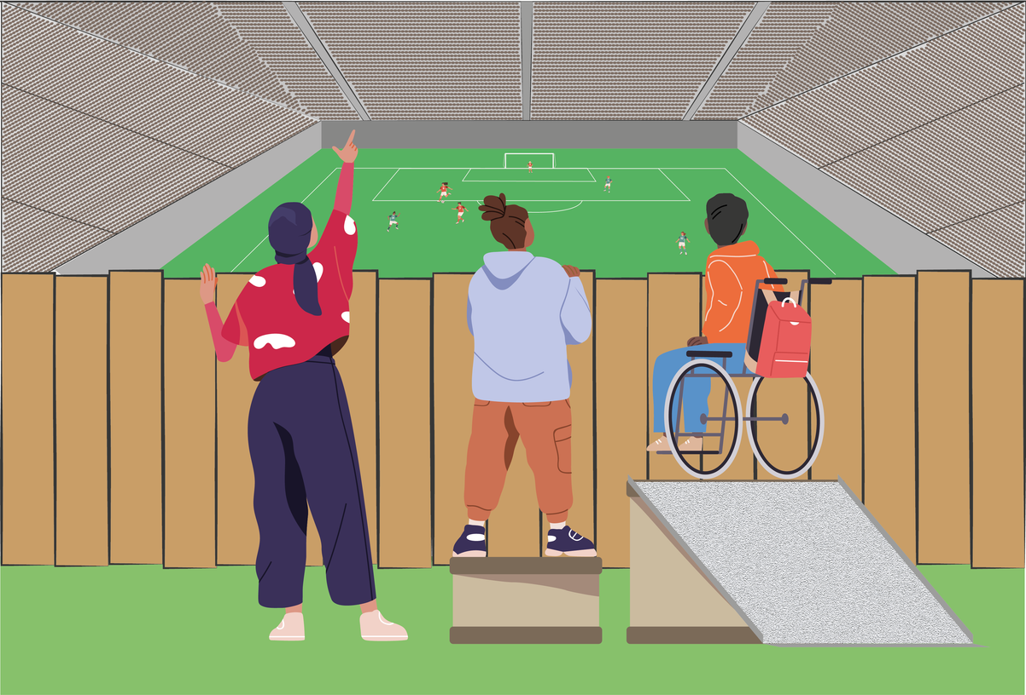
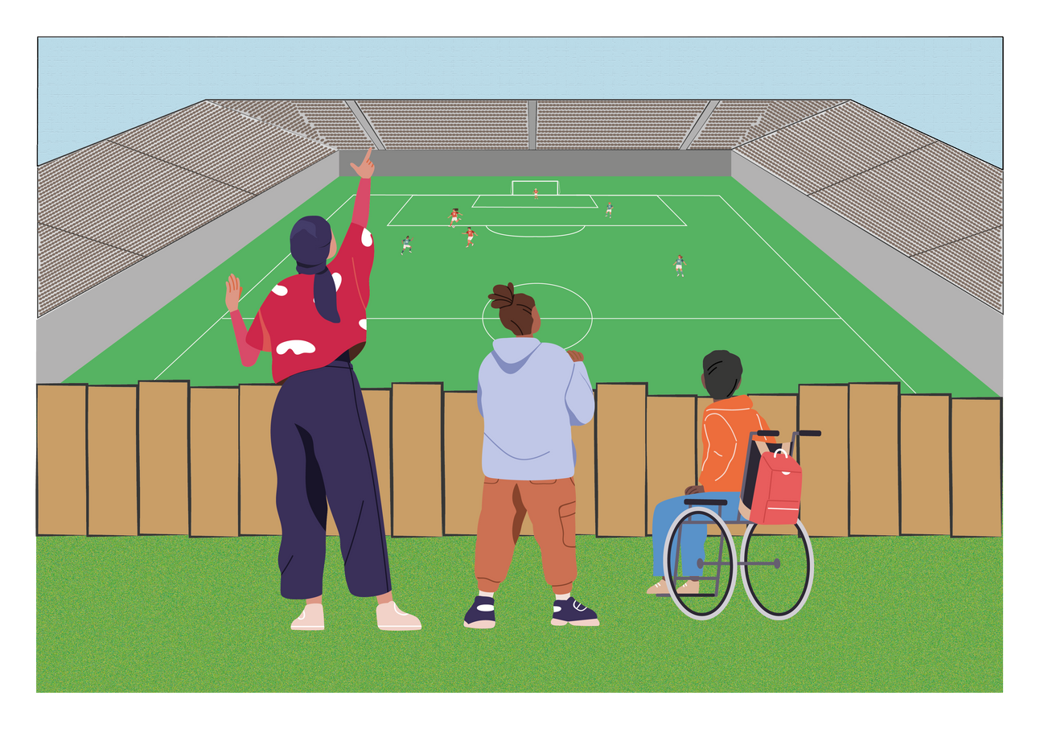
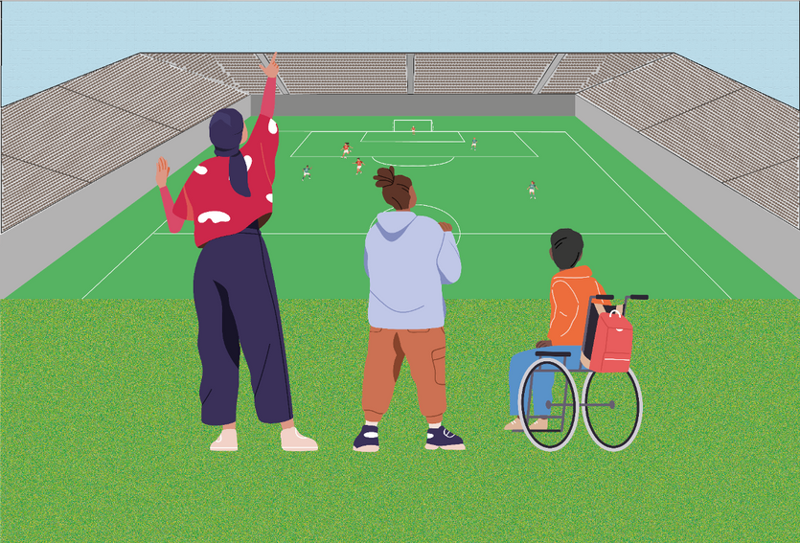
Approaches
Support approaches
Other D&I approaches
Social Justice approaches
Add-ons to support those who ‘don’t fit the norm’
Reform the norm to increase sense of belonging
Challenge and dismantle inequitable norms, in and outside the classroom
Notes:
Then there are other approaches which focus more on inclusion and/or social justice.
Support approaches: Support approaches provide targeted assistance to students who are seen as not fitting the norm. These are often implemented as extracurricular or supplemental programs (e.g. mentoring, tutoring, or bridging initiatives) that aim to help students cope and succeed within the existing structure rather than transforming that structure.
Other D&I Approaches: Other D&I approaches work to reform the dominant norm to foster a greater sense of belonging. These strategies often involve integrating more diverse perspectives into curricula, integrating more inclusive teaching practices to accommodate different learning styles and backgrounds in class, encouraging and incorporating student feedback, and fostering a sensitivity to diversity and inclusion among students. The aim is to shift the culture and content of education to be more inclusive by design.
Social justice approaches: Social justice approaches are transformative. They aim to challenge and dismantle inequitable structures both within and beyond the classroom. Drawing from frameworks like critical pedagogy, anti-racist education, and decolonial thought, this approach empowers students to critique dominant narratives, co-create knowledge, and develop critical consciousness to pursue systemic change.

Slide 4
Approaches
Support approaches
Other D&I approaches
Social Justice approaches
Few to no changes to the standard curriculum/pedagogy; extracurricular | More diverse representation in curriculum and avoiding stereotypes | Challenge dominant, oppressive narratives in the curriculum
Additional support services, programs, or institutions to accommodate needs | Integrate diverse means of engagement, information, evaluation in pedagogy | Legitimize diverse ways of knowing, learning and being (‘epistemic justice’)
Mentoring, tutoring, development and well-being initiatives | Student input & feedback | Curriculum co-creation and other subversions of academic hierarchies
Stimulate resilience, responsibility and coping strategies in students | Adopt inclusive teaching practices and raise awareness among students | Stimulate critical consciousness in students and empower
Safe(r) spaces for marginalized groups | Brave spaces to discuss sensitive topics | Accountable or principled spaces
Notes:
Different characteristics of these approaches

Slide 5
Approaches
Support approach
D&I approaches
Social Justice frameworks
Support those who ‘don’t fit the norm’
Challenge and expand the norm,
to include more people
Challenge and subvert the norm,
to dismantle inequity
Pedagogy of Excellence
(Adolfo Bermeo - AAP UCLA)
Social Justice Education
(Lee Anne Bell, Mauriana Adams)
Universal Design for Learning
(CAST - US)
Anti-racist pedagogy
(Ibram X. Kendi, Battina Love)
Student Retention
(Vincent Tinto, etc.)
Inclusive Excellence
(Frank Tuitt)
Critical pedagogy
(bell hooks, Paulo Freire)
Trauma-Informed Pedagogy
(Mays Imad, etc.)
Culturally Responsive Pedagogy
(Gloria Ladson-Billings, Geneva Gay)
Special education
Inclusive Digital Pedagogy
(E-inclusion)
Decoloniality in education
(Sabelo Ndlovu-Gatsheni, Walter Mignolo, Catherine Waslh, etc.)
Notes:
These approaches are not mutually exclusive, nor is one ‘better’ than the other: in practice, they often overlap each other based on what is both possible, fitting and desirable in a given context.
These are some examples of existing frameworks and approaches, which you can research later depending on what you are looking for.
Student Retention Theories (Vincent Tinto): Focus on creating conditions—academic, social, and structural—that keep marginalized students engaged and enrolled.
Pedagogy of Excellence (Adolfo Bermeo – Academic Achievement Program UCLA): Advocates for high expectations and robust support systems for underrepresented students to thrive.
Special Education: Provides tailored instruction and services for students with disabilities or specific learning needs.
Trauma-Informed Pedagogy (Mays Imad, etc.): Recognizes the impact of trauma on learning and promotes supportive, compassionate teaching practices.
Universal Design for Learning (UDL) (CAST): Promotes flexible learning environments that accommodate diverse learners by offering multiple means of engagement, representation, and expression.
Inclusive Digital Pedagogy (E-inclusion): Focuses on making online and blended learning spaces accessible and inclusive.
Inclusive Excellence (Frank Tuitt): Combines academic excellence with diversity and inclusion, asserting that true excellence must include equity
Critical Pedagogy (bell hooks, Paulo Freire, etc.): Encourages students to question power structures, engage in dialogue, and see education as a tool for liberation.
Social Justice Education (Lee Anne Bell, Maurianne Adams, etc.): Focuses on developing critical awareness and action to address inequality, both in and outside the classroom.
Anti-Racist Pedagogy (Ibram X. Kendi, Bettina Love, etc.): Confronts racism directly by embedding anti-racist principles in curriculum, teaching, and institutional policy.
Decoloniality in Education (Sabelo Ndlovu-Gatsheni, Walter Mignolo, Catherine Walsh, etc.): Aims to deconstruct Eurocentric knowledge systems and legitimize Indigenous and marginalized epistemologies.

Slide 6

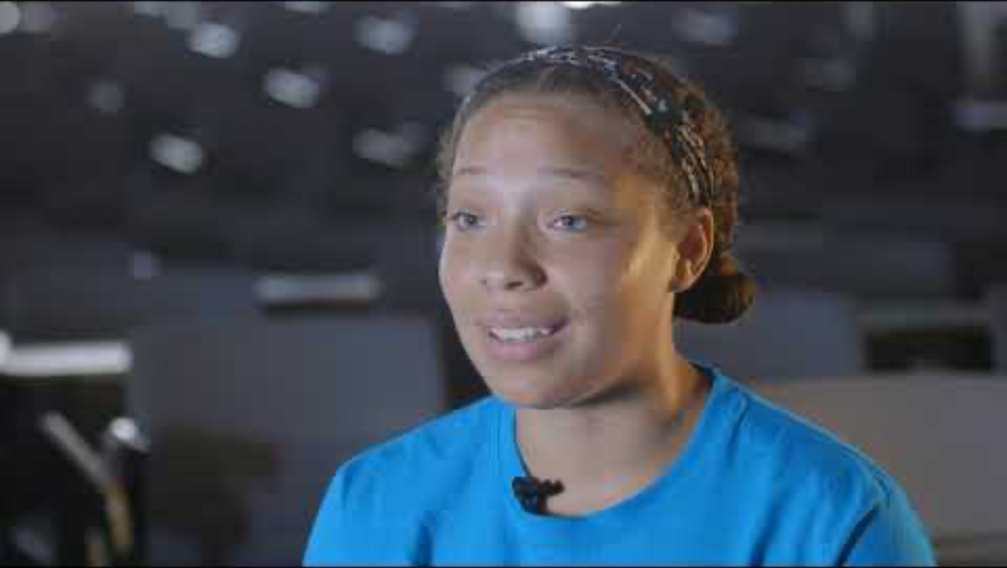
Example support approach
Bridging program UCLA for transfer students from community colleges
Notes:
Option to show support approach examples to illustrate point. Choose your own example or one of our suggestions:
- EUR Pre Academic Program: Example of ‘soft landing’ at Erasmus University https://www.eur.nl/en/education/bachelor-programmes/admission-and-application-bachelor/pre-academic-programme
- UCLA Centre for Community College Partnerships (CCCP): Example of outreach
program to increase transfer rates from historically underrepresented communities from
community colleges to UCLA (US) (see slide): https://www.youtube.com/watch?v=sw75gGiS-ro
- UCLA Academic Advancement Program (AAP): Example of a ‘soft landing’ and
retention program for historically underrepresented communities at UCLA https://multinclude.eu/case/academic-advancement-program-aap-at-ucla/
Note: all of these good practices are part of a broader, integrated approach to that are contextual to these universities

Slide 7
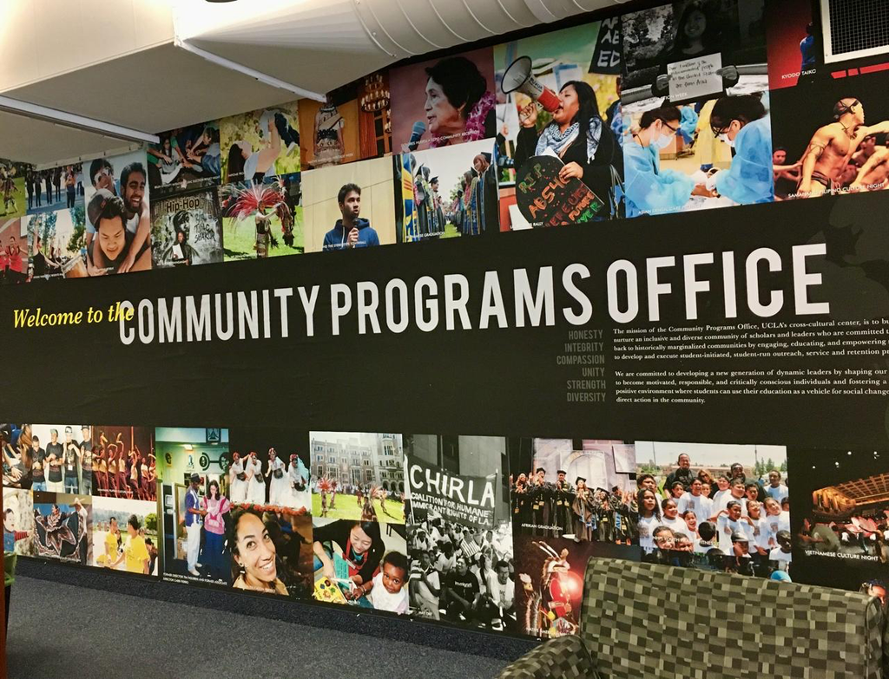
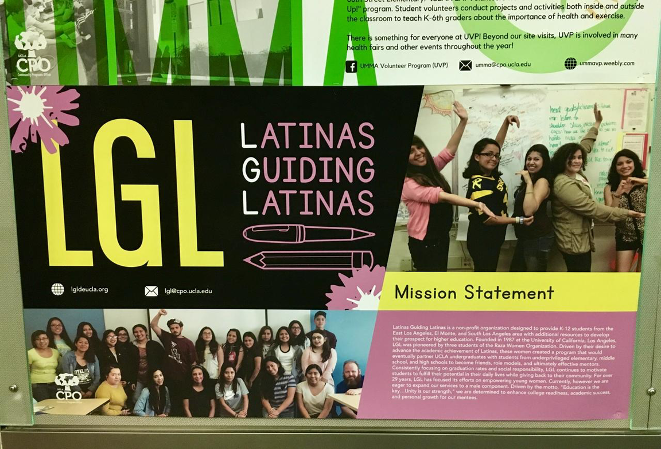
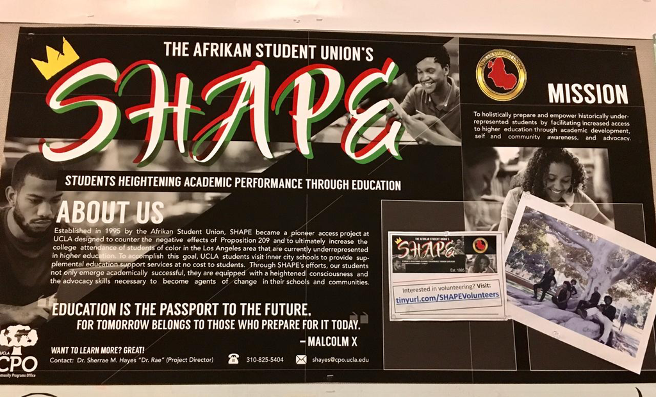
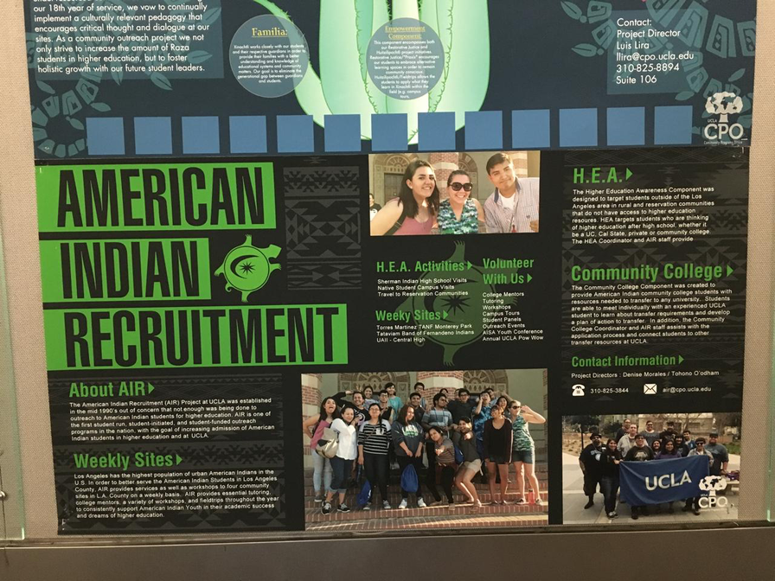
Example support approach
Student-led
community programs
UCLA
Notes:
Whereas the example on the previous slide is a institutionally-led support approach, there are also support approaches which are student-led, such as these community programs at UCLA. The institution only facilitates the space and other necessities (via the UCLA Community Programs Office), but the community support programs are led by students.
https://cpo.ucla.edu/

Slide 8
Approaches
Support approaches
Other D&I approaches
Social Justice approaches
Add-ons to support those who ‘don’t fit the norm’
Reform the norm to increase sense of belonging
Challenge and dismantle inequitable norms, in and outside the classroom
Notes:
Just reiterating that with the previous examples, we were looking at support approaches. However, there are also things you can implement in your classroom that also relate to the Other D&I approaches and/or Social Justice approaches. This is what the next exercise is about.

Slide 9

Inclusive teaching practices
  Draw 1 inclusive teaching practice card per person
  Discuss these different practices in groups
How could you adapt these strategies to your classes? Or how do you already?
What challenges might arise? How could you address them?
Are any of these strategies especially relevant in your national, institutional or disciplinary context?
Image: Chidiebere Ibe
Image relates to the card ‘Diverse representation and perspectives in curriculums’
Notes:
Instructions for the facilitator:
1. In advance, prepare for the session by printing and cutting the teaching practice cards in the appendix. Fold the cards closed and put them in a hat or box.
2. Introduce the different approaches to inclusive teaching practices using the information, slides and other resources of this module.
3. Afterwards, introduce the activity. Have each participant draw one of the folded inclusive teaching practice cards from the hat/box. Then, ask them to form groups of 2-3 people.
4. Let the groups freely discuss their different practices with each other. Some discussion questions are already on the cards, but there are also some general discussion questions shown on the slide.
- After 15-20 minutes, ask the groups to share some of their reflections with the whole group.

Slide 10
Inclusive teaching practices
A non-exhaustive list:
  Diverse representation and perspectives in curriculums
  Allowing, offering and encouraging multiple ways to engage, learn and access content
  Flexible assessments
  Content notes / trigger warnings
  Bias-reducing rubrics
  Inclusive language
  Equitable participation strategies
  Social justice education
  Involve students in curriculum design
  Avoiding and challenging stereotypes
  Etc. Any practices you want to share?
Notes:
An overview of the different inclusive teaching practices that were discussed on the cards.
Invite the group to share any other practices that they know of or already implement in their classroom.

Slide 11
Practical resources
A non-exhaustive list:
  Universal Design for Learning Guidelines – CAST (US)
  Inclusive Teaching Resources – Brown University (US)
  Inclusive Higher Education Framework (UK)
  Inclusive Curriculum Design Toolkit – Higher Education Academy of Advance HE (UK)
  Trauma-Informed Pedagogy – University of Michigan (US)
  Handbook for Inclusive Digital Education – E-inclusion (EU)
  Critical Practices for Social Justice Education - Learning for Justice (US)
  The Uprising: Educational Toolkit – A Guide for Educators to Engage Students in Decolonizing the Mind - Pravini Baboeram (NL)
  Etc. Any resources you want to share?
Notes:
An overview of practical resources with links, for if you send the slides to the participants.

