Slide 1

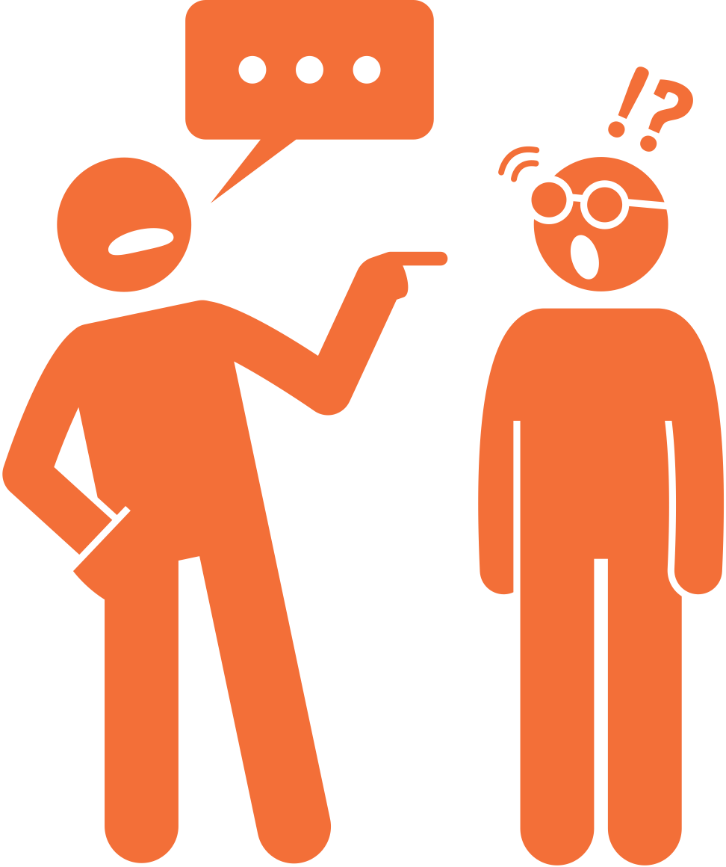



Module 3
Microagressions
Recognizing and becoming an active bystander

Slide 2
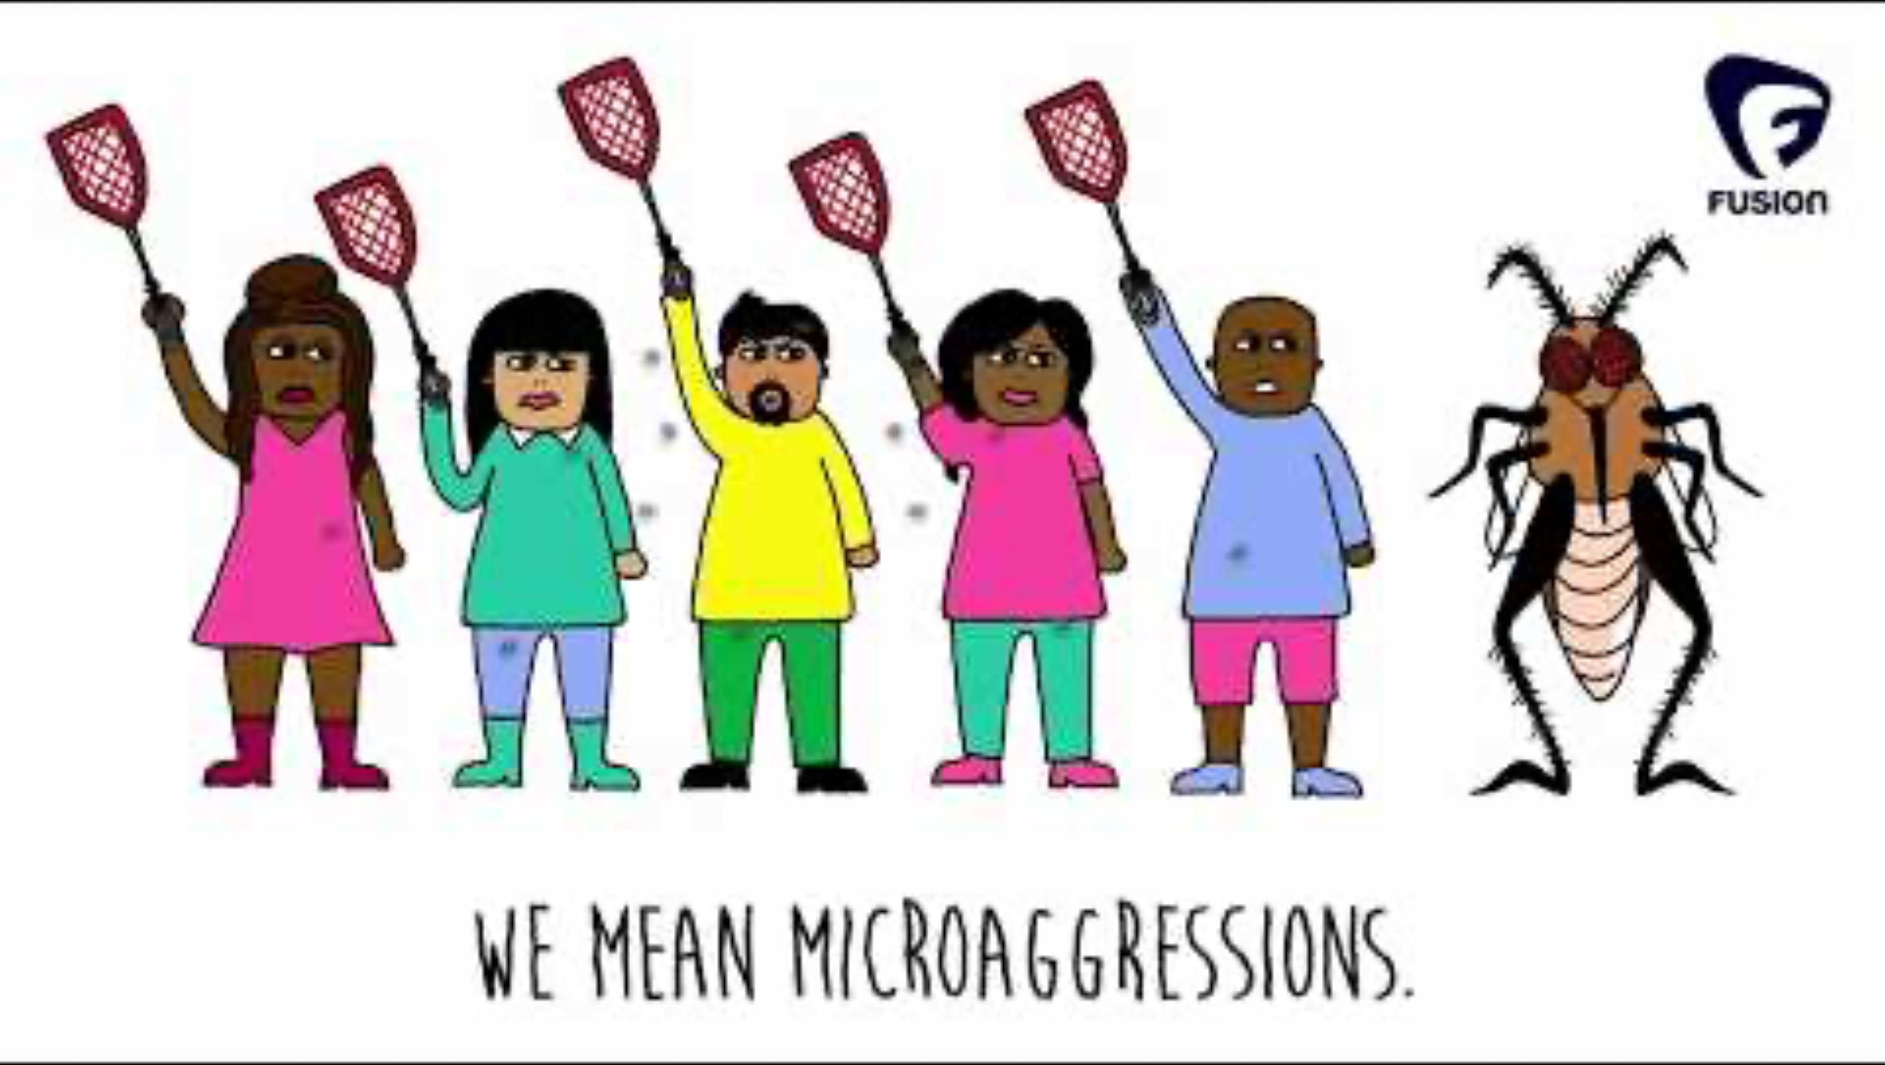
https://www.youtube.com/watch?feature=oembed&v=nQ9l7y4UuxY
Notes:
Watch the video together. https://www.youtube.com/watch?feature=oembed&v=nQ9l7y4UuxY

Slide 3
Microagressions
Micro:
Everyday, subtle, and (un)intentional acts or expressions that communicate hostile, derogatory, or negative messages toward marginalized groups.
Agressions:
Harmful cumulative effects, both on the individual and beyond
Sue et al. (2007)
Sue (2010)
Notes:
Microaggressions are ‘everyday’, subtle, often unintentional comments or actions that communicate bias, prejudice or a stereotype toward individuals from marginalized groups. They may seem minor, but over time, their cumulative effect can cause significant psychological, physiological and societal harm.
Microaggressions:
• reinforce stereotypes;
• undermine professional and social confidence;
• create unwelcoming or unsafe environments in schools, workplaces, and communities;
• are often normalized — treated as jokes, misunderstandings, or overreactions, often left unchallenged — which is why it’s critical to recognize and disrupt them early.
[Use examples to illustrate the concept and its effects throughout the session.]

Slide 4
Individual impact
Compounding impact of these repeated ‘mosquito bites’:
  Psychological
    Chronic stress and well-being issues
  Physiological
    Stress ⟶ Can affect heart, blood pressure, hormones
  Professional/academic
    Deteriorates ‘sense of belonging’
    Impaired academic performance
    Decreased job satisfaction and increased turn-over
Notes:
While these remarks and actions may not be intended to harm, their impact remains negative regardless of intent. It is typically not a single remark in itself that causes harm, but the act of being repeadetly confronted with the same remarks or stereotypes on a frequent basis. In a way, microaggressions are like mosquito bites: one might not bother you, but getting bitten repeatedly, every day, can wear you down.
• Psychologically, repeated exposure leads to chronic stress, anxiety, and symptoms of depression, as individuals internalize feelings of exclusion, devaluation, or hypervigilance in everyday interactions
• This persistent stress doesn't remain in the mind— it can manifest physiologically: elevated cortisol levels and systemic inflammation can impair immune function, contribute to cardiovascular issues, and reduce overall energy and cognitive capacity
• In academic and professional settings, microaggressions undermine motivation, concentration, and confidence, leading to a weakened sense of belonging, impaired academic performance, lower job satisfaction, and increased likelihood of attrition and turnover
--> The harm caused is not only personal but also institutional, as environments that tolerate microaggressions often struggle to retain diverse talent and foster truly inclusive cultures

Slide 5
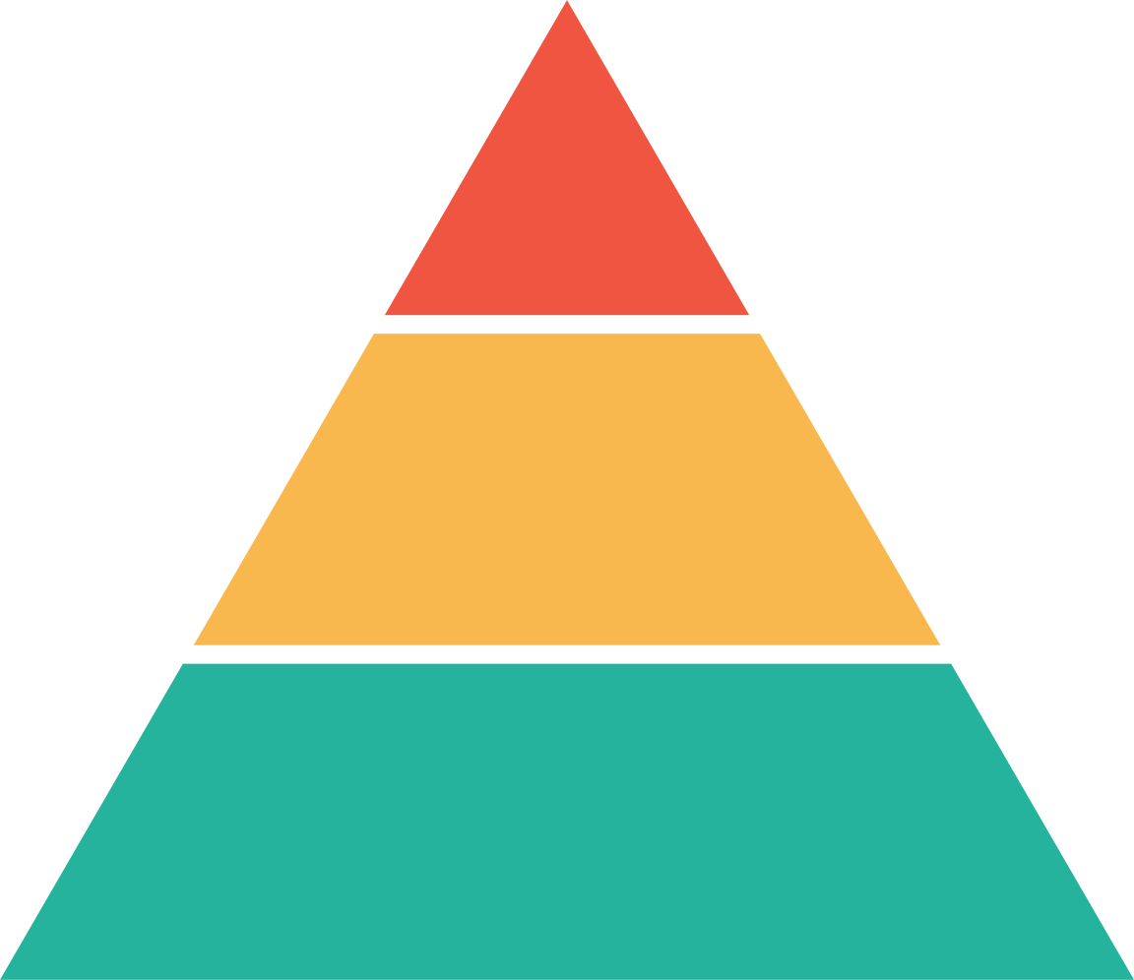
Explicit Violence
Broader impact
E.g. hate crimes, state violence
Every time we ignore or excuse subtle bias, we reinforce a system where bigger harms become more acceptable.
Discrimination
By individuals, groups & institutions (e.g. employment, political, housing, educational, health care)
See also Skinner-Dorkenoo et al. (2021)
Bias & Prejudice
E.g. micro-agressions, stereotyping, belittling jokes,
non-inclusive language, bigotry, scapegoating
Simplified model, adapted from the Anti-Defamation League (ADL)
Notes:
Besides the individual impact, there is also a broader impact. Microagressions are part of a broader system of bias and discrimination. Every time we ignore or excuse subtle bias, we reinforce a system where bigger harms become more acceptable.
The Pyramid of Hate, developed by the Anti-Defamation League (see figure on slide for a simplified adaptation), illustrates how individual attitudes and behaviors, if unchecked, can contribute to increasingly severe forms of bias and violence. At the base are implicit biases, stereotypes, and microaggressions— everyday expressions of prejudice that are often dismissed as harmless or unintentional. But when these are normalized and tolerated, they begin to shape the social climate, reinforcing the idea that certain groups are “less than,” “foreign,” or “suspicious.” Over time, these biased attitudes lay the psychological groundwork for more overt acts of discrimination, such as exclusion from opportunities, unequal treatment, or institutional policies that disadvantage marginalized groups.
As this climate of normalized bias intensifies, it becomes easier for more extreme expressions (e.g. verbal harassment, hate crimes, or state-sponsored violence) to emerge and even gain social acceptance. The key message here is that bias doesn’t begin with violence— it begins with silence. Stopping the escalation means interrupting harmful behaviors and narratives early, at the everyday level.

Slide 6
Active bystander
  People who witness unacceptable behavior but who are not directly involved as perpetrator or victim.
  Bystanders can actively intervene in the situation by speaking out, convincing others to react, or by calling for help.
Scully & Rowe (2009)
Notes:
An active bystander is someone who not only witnesses a problematic situation but chooses to speak up or take action. Bystanders have the power to challenge harmful norms, support those affected, and signal what behavior is acceptable in a group.

Slide 7
Activity 1: Reflection
Do you recognize microaggressions from your own experience?
As a receiver, sender and/or bystander?
5 minutes in pairs & 10 minutes altogether
Notes:
Choose one or more of the following activities.
Tip: Remind participants to respect confidentiality and only share what they’re comfortable sharing.
Finish with summarizing different intervention strategies (e.g. take-away slides) and emphasizing that there is no ‘right’ intervention, as they are all context-dependent.

Slide 8
Activity 2: What would you do?
During the weekly team meeting, the discussion focuses on how to better reach underrepresented groups. While reviewing the profile of these groups, you notice that several colleagues express various assumptions and stereotypes about them.
When would you say something?
A: I wouldn’t
B: After the first comment
C: After the most hurtful comment
D: After the meeting
E: Other...
Notes:
One of the activity options you may choose to include.
Invite participants to discuss, optionally first in pairs, then with the larger group:
• What they would do and why?
• What impact each choice might have?
Tip: Emphasize there is no single “right” answer— the goal is to explore and reflect.
Finish with summarizing different intervention strategies (e.g. take-away slides) and emphasizing that there is no ‘right’ intervention, as they are all context-dependent.

Slide 9
Activity 2: What would you do?
During lunch, Colleague A makes a joke that was meant in good fun, but Colleague B finds it hurtful. When Colleague B says they didn’t appreciate the joke, Colleague A responds with, “Oh come on, don’t be so sensitive—it was just a joke! You can’t say anything these days without someone taking offense.
How would you respond as a bystander?
A: I wouldn’t- it was just a joke.
B: I would say the joke was very inappropriate and that he can’t say that.
C: I would say the joke made me feel uncomfortable.
D: Other...
Notes:
Another scenario you may choose from for activity 2

Slide 10
Activity 3: Role play
1. Brainstorm case studies. In groups, discuss fictive or real-life situations involving microagressions in/around the workplace or classroom.
  Think: What was a time that you wish you had done something, but didn’t?
2. In your group, choose one suitable case and prepare a role play.
  In the play, there should at least the roles of a sender, receiver and a bystander.
  Think of a base scene (how the situation actually played out) before thinking of solutions
3. Once all groups have prepared a case, each group presents their role play. Altogether, we will choose one case study which we will use to dive deeper into, to explore different interventions.
Notes:
The last activity you may choose for your workshop.
Prompt: "What is a situation where you wish you had spoken up, but didn't?" --> This is your chance to re-do it!

Slide 11
Activity 3: Role play
Round 1: Base scene
• Performing the scene as it originally happened
• Everyone who is not performing, is an active observer
Round 2, 3, 4….: Alternative scenes
• Play the scenario again, but this time, observers get the chance to step in, take on different roles and try out different strategies
Goal: experiment what does/does not work in particular situations, build experience as an active bystander in a training environment
Notes:
Once the case has been selected, multiple rounds will be played.
Tip: Offer positive feedback and focus on learning— not performance.
Finish with summarizing different intervention strategies (e.g. take-away slides) and emphasizing that there is no ‘right’ intervention, as they are all context-dependent.

Slide 12
Take-aways

Slide 13
Possible strategies
When witnessing unacceptable behavior, you can:
  Distract → to prevent escalation.
  Direct Action → name what you see and address the person causing discomfort and insecurity. Assess possible risks.
    See next slide for possible ways to do this
  Delegate → ask for help from someone with authority or responsibility
  Delay → check in with the person after the incident
  Document → record the situation and discuss with the victim what to do with it
Source: Right To Be.
Notes:
When you witness a microaggression or other unacceptable behavior, you may use one or more of the 5Ds — five practical strategies from bystander intervention research:
• Direct Action – Address the behavior head-on.
“Hey, I don’t think that comment came across the way you intended.”
• Distract – Shift the focus to de-escalate.
“Sorry to interrupt — can I grab you for a quick sidebar?”
• Delegate – Involve someone else with more authority.
“Can we check in with HR or the facilitator about that comment?”
• Delay – Check-in with and support the person after the incident.
“I saw what happened earlier — are you okay?”
• Document – Take notes or record a video of a public incident (if legal, safe and appropriate to do so) as a witness testimony or proof
“I recorded / wrote down what happened – what would you like me to do with it? Would you like help reporting this incident?”

Slide 14
How to take Direct Action?
  Address → I see this happening, and I am uncomfortable with it.
  Challenge → I don't think it's okay what's happening here.
  Question → what exactly do you mean by that?
  Explain → this is why what is happening here is not okay.
  Correct → what you are doing is not okay.
  Check interpretation → this is what I think you said/did, is this what you meant?
Notes:
When taking Direct Action and addressing the person causing the incident directly, you could apply one or more of the following strategies depending on the context

Slide 15
References
Anti-Defamation League (2021). Pyramid of Hate. https://www.adl.org/sites/default/files/pyramid-of-hate-web-english_1.pdf
Lui, P. P., & Quezada, L. (2019). Associations Between Microaggressions and Adjustment Outcomes: A Meta-Analytic and Narrative Review. Psychological Bulletin, 145(1), 45–76.
Right To Be (n.d.) The 5Ds of Bystander Intervention. https://righttobe.org/guides/bystander-intervention-training/
Skinner-Dorkenoo, A. L., Sarmal, A., André, C. J., & Rogbeer, K. G. (2021). How Microaggressions Reinforce and Perpetuate Systemic Racism in the United States. Perspectives on Psychological Science, 16(5), 903-925. https://doi.org/10.1177/17456916211002543
Solórzano, D. G., & Huber, L. P. (2020). Racial microaggressions: Using critical race theory to respond to everyday racism. Teachers College Press.
Sue, D. W. (2010). Microaggressions and Marginality: Manifestation, Dynamics, and Impact.
Sue, D. W. & Spanierman, L. (2020). Microaggressions in Everyday Life: Race, Gender, and Sexual Orientation.
Sue, D. W., Capodilupo, C. M., Torino, G. C., et al. (2007). Racial microaggressions in everyday life: Implications for clinical practice. American Psychologist, 62(4), 271–286. https://doi.org/10.1037/0003-066X.62.4.271
James-Bayly, Savannah. (2022). “Microaggressions: Why and How do they Impact Health?” Medical News Today. https://www.medicalnewstoday.com/articles/microaggressions-how-and-why-do-they-impact-health#Microaggressions-direct-impact-on-health

