Slide 1

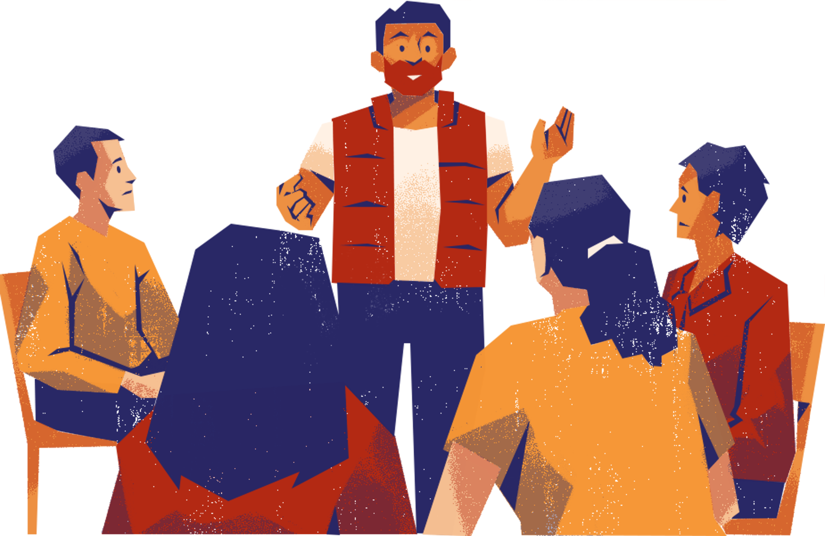



Module 2
Creating safe(r), brave and accountable spaces

Slide 2
Intentional spaces
Safe(r) space | Brave space | Accountable space
Like-mindedness | Diversity of perspectives | Social justice oriented
Affirming & validating | Challenging & questioning | Accountability & allyship
Search for comfort | Engage to learn, ‘stretch’ | Align intentions with actions
Mental recharge | Mental labour | Critically examining and changing behavior
E.g. Supportive separate (peer) spaces for (marginalized) students | E.g. Classroom discussions, especially surrounding controversial topics | E.g. Social justice oriented classrooms; student action groups
(ideally, all are present on an inclusive college campus!)
Notes:
Safe(r) spaces are designed to reduce harm and provide support—especially for marginalized groups. These spaces act as shelters from other environments where discrimination or exclusion may occur. They are guided by shared values and rules (spoken or unspoken) that help ensure care, validation, and community among like-minded individuals. Safe(r) spaces can help people feel less isolated and more confident by building a sense of belonging and emotional safety. These spaces are not about avoiding all difficult topics, but about centering protection and healing where it is most needed.
Brave spaces are focused on dialogue, learning, and mutual understanding. They acknowledge that in settings like classrooms or team discussions, people bring different perspectives, experiences, and opinions—some of which may clash. In a brave space, participants are encouraged to engage openly, even if that means facing discomfort or disagreement. The goal is not to avoid difficult conversations, but to manage them thoughtfully. A skilled facilitator helps guide the process, setting clear conditions for discussion to ensure that conversations remain respectful and constructive.
Accountable spaces build on both safe(r) and brave spaces. They explicitly recognize power dynamics and emphasize personal and collective responsibility. Like brave spaces, accountable spaces tend to have (pre-)determined rules and conditions to navigate the space. In these spaces, participants agree to be held accountable for the impact of their words and actions—not just their intent. Accountable spaces also aim to reduce the burden often placed on marginalized individuals by sharing responsibility for maintaining respectful and equitable dialogue. These spaces tend to work best in groups that already have a strong commitment to equity and inclusion.
These spaces are not mutually exclusive, but complementary to one another.

Slide 3
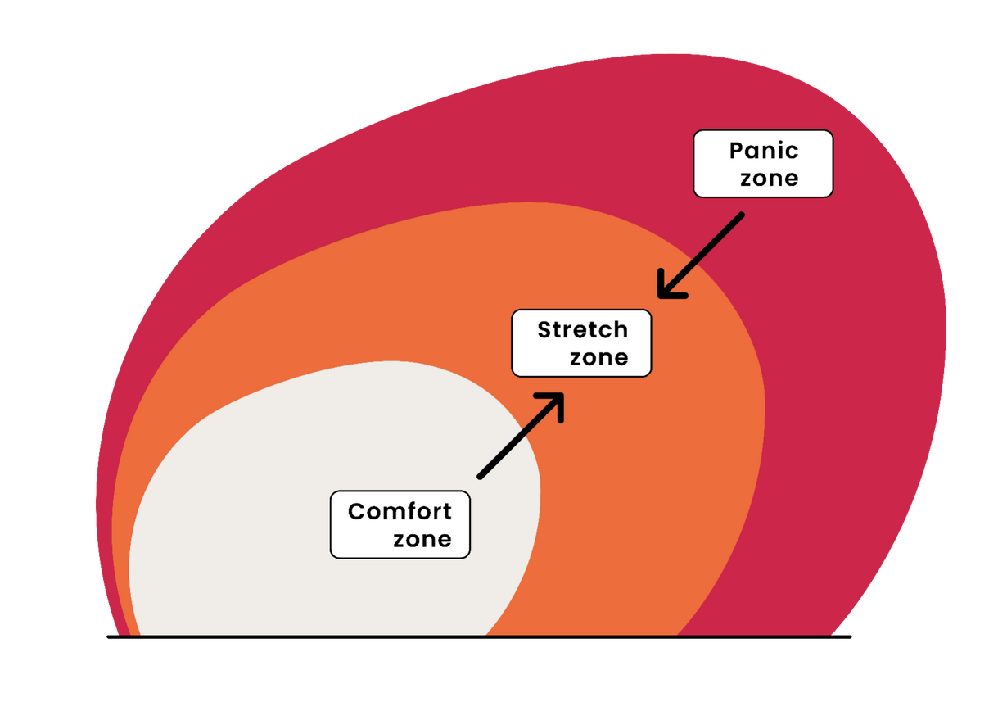
Getting comfortable with the uncomfortable
Notes:
If we were to translate the feelings associated with these spaces to this model, we would say that the safe(r) space intends to keep participants in their comfort zone, where they can rest and mentally recharge from the exclusion and lack of understanding they experience elsewhere. On the other hand, we would associate the brave and accountable spaces with the stretch zone; a zone in which we can sometimes be challenged for the sake of learning.
The conditions of the safe, brave and accountable spaces are to avoid (in so far is possible) that any participants go into 'panic zone', a zone characterized by not just discomfort, but unsafety. This space is also where constructive conversation and learning processes effectively end.

Slide 4

Facilitating a safe(r) space
WHERE & BY WHO?
HOW TO FACILITATE?
  Typically outside the classroom
  (Student-led) peer-to-peer initiatives
  Institutional trustees, counsellors, teachers and services providing support
(Either pre-determined, collectively drafted or organically emerging)
  (In)formal conditions and procedures to ensure a greater feeling of safety, trust and belonging for target group
  Deep compassion and (critical) understanding of lived experiences
  Strive to eliminate harm in and around the space
SAFE FOR WHO?
  Historically, safe(r) spaces mainly organized for marginalized or vulnerable peoples
  ‘Everyone is welcome’ ≠ everyone is safe ⟶ therefore safe(r) spaces have to ‘exclude’ those who may cause harm
(Balance between accessibility and visibility)
Notes:
In higher education, safe(r) spaces can be:
• Institutional: for example, a space facilitated by a confidential counseller, for example to discuss sensitive issues and experiences like harassment, discrimination, etc.
• Student-led: for example, a LGBTQIA+ center led by and for LGBTQIA+ students and allies. A student-led safe(r) space may be facilitated by the institution in terms of physical space, but it is organized on a peer-to-peer basis.
In order to remain safe, safe(r) spaces typically put restrictions on who can enter the space, in order to ensure that those for who the space is intended can feel safe in the presence of like-minded people.
To facilitate a safe space, spoken on unspoken rules/conditions govern the space to ensure a greater feeling of safety. These can be collectively agreed upon by the group in question, or pre-determined. The facilitators and participants of the space have a deep compassion and critical understanding of the lived experiences of the participants and can therefore provide the necessary affirmation and validation. The goal is to eliminate harm in and around the space

Slide 5
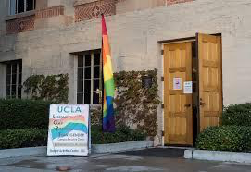
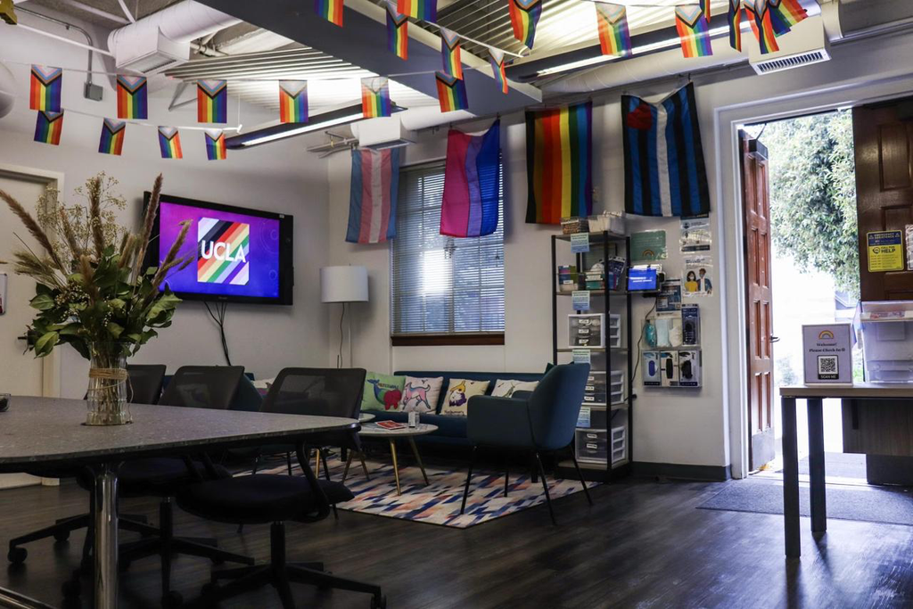
Example safe(r) space
LGBTQIA+ center within the UCLA Bruin Resource Center
Notes:
LGBTQIA+ center within the UCLA Bruin Resource Center is an example of a safe(r) space [you can also instead include your own example]. In this student-led space – facilitated by the institution – LGBTQIA+ students and allies can meet each other. One of the notable ways in which they safeguard the space and make it accessible is by having both a front and back entrance. The visible front entrance makes sure the space is known by all students, while the back entrance ensures that students who do not want to be seen can also discreetly enter.

Slide 6
Considerations safe(r) spaces
Spaces to complain, report or give feedback
Safe(r) spaces can offer individual support, but can also be a starting point for (institutional) change
However, common problem of underreporting in spaces that are supposed to be ‘safe’ to report. In part due to:
  Expectations: Lack of trust that institution will take report seriously
  ‘The brick wall’: Institutions are resistant to change
  Emotional labor: Those who complain become the problem
  Bureaucracy: Lack of transparent, accessible infrastructure
  Consequences: Study delays, punishments
  Normalization: Students/staff can’t always recognize when they are victimized
Extra resources: Sara Ahmed - Complaint! & On Being Included
Notes:
Institutional safe(r) spaces, such as spaces to complain, report or give feedback to for example a counsellor, can offer individual support to students/staff. But that can also be a starting point for (institutional) change, especially if issues are formally reported or complaint procedures are put in motion.
However, institutional barriers may lead to these spaces not always feeling safe or effective enough. This leads to a structural problem of underreporting when it comes to discrimination and harassment. People who consider complaining/reporting often run into the following problems:
- A lack of trust that the institution will take the report seriously, for example due to other reports not being taken seriously or due to an institutional culture that does not value this
- Institutions are resistant to change and people who 'complain' often run into a metaphorical 'brick wall' (Sara Ahmed)
- A lot of emotional labor, including having to retell traumatic stories, repeatedly having to defend themselves, and becoming marked as 'the problem' by the institution
- A lack of transparent, accessible infrastructure makes that people cannot always find right places/people to report, or that they become too exhausted from being sent from one place to the next
- People who complain/report may run the risk consequences/punishment. Students may face study delays or fear a bad grade from their teacher. This prospect can make people less inclined to report/complain.
- Finally, people cannot always recognize that they have been the victim of harassment/discrimination/bullying etc., especially those who have experiencing this all their lives.

Slide 7
Facilitating a brave space
WHEN & WHERE?
HOW TO FACILITATE?
  In general classroom or staff meetings
  Or specifically when engaging with particularly sensitive/controversial issues in (politically) diverse settings
(Either pre-determined or collectively drafted;
it is not ‘anything goes’)
  State intentional decision to engage with potential discomfort in order to learn
  Create explicit guidelines/conditions to ensure a constructive, respectful conversation about uncomfortable topics
  Give equal value to different perspectives
  Foster awareness and (self-)reflection on what perspectives and positions of power yourself and others are speaking from
FOR WHO?
  Everyone is welcome: space for diversity of (political) views, starting points and stages of learning
Notes:
A brave space can be facilitated in for example a class room or staff meeting. This can be always, for example during every class or staff meeting, or specifically when engaging with particularly sensitive/controversial issues with (politically) diverse participants (for example a recent political event in the news or on campus). The premise of a brave space is that everyone and all opinions/perspectives are welcome, as long as they adhere to the guidelines/conditions of the brave space. To facilitate a brave space, one must co-create or state these conditions explicitly at the beginning of the session. The facilitator must also give equal value to all perspectives falling within these conditions and ideally position these perspectives throughout the conversation. Where is someone speaking from? What experiences/knowledge makes them have this perspective? It is up to the facilitator and the participants to foster this kind of awareness and (self-)reflection.

Slide 8
Accountable space
DIFFERENCE WITH BRAVE SPACE
EXAMPLES OF GUIDELINES
Source: Elise Ahenkorah
  Do not interrupt.
  Listen actively, instead of just waiting to speak.
  Be mindful of how long you talk and give everyone a chance to speak, without unnecessary pressure.
  Understand that we are all learning. If you said something offensive or problematic, apologize for your actions or words being offensive — not for the person feeling insulted.
  Recognize and embrace friction as evidence that multiple ideas are entering the conversation — not that the group is not getting along.
  Ask for clarification — do not assume or project.
  Give credit where it is due. If you are echoing someone’s previously stated idea, give the appropriate credit.
  Speak for yourself. Use “I” statements and do not share others’ lived experiences.
  Words and tone matter. Be mindful of the impact of what you say, and not just your intent.
  Don’t place the burden of educating yourself on others, especially those from equity-deserving communities.
  If you attend as an ally of the community, please allow space for equity-deserving and marginalized communities to share their experiences.
  Other — ask your audience if there are other guidelines needed to support them to ensure the conversation does not create further trauma or undue mental or emotional hardship.
  Requires individuals to be responsible for their own actions, intentions, and words
  Equity prioritized rather than equality of perspectives
  Therefore, stronger focus on allyship (i.e. lifting burdens from marginalized individuals in the space)
Notes:
Facilitating the accountable space is similar to the brave space, but it requires individuals to be more responsible and aware of their own actions, intentions and words. Rather than taking a 'all opinions are welcome' approach, the accountable space prioritizes the idea of equity and social justice principles. Therefore, while many accountable space conditions correspond with brave space conditions ('do not interrupt', 'listen actively', etc), the conditions has a stronger focus on allyship with marginalized communities. Therefore, facilitating a space like this only works when there is already an shared awareness and mutual commitment to social justice in a space, which is not always the case in for example a classroom.
On the slide some examples of conditions are listed. As you can see, some of them focus more heavily on allyship and accountability, while others can also be applicable to more general spaces.

Slide 9
Exercise
Activity 1: Reimagining safe(r) spaces at the faculty
First alone brainstorm (2min), then exchange in groups
Focus on:
  What groups/people are in need of safe(r) spaces at the faculty?
  What could these spaces look like?
  Who should be responsible to organize and ensure safety in these spaces?
Activity 2: Drafting (discussion) guidelines for your own classroom
First alone brainstorm (2min), then exchange in groups
Consider:
  Positioning your role as educator
  Your expectations from students
  How to ensure constructive, respectful, but ‘brave’ discussions
  Red lines (and accountability)
Notes:
Here are two activities, to be done in groups or individually, to explore how the principles of safe(r), brave and accountable spaces can be made relevant for your institution, department or classroom. Choose and adapt one or both activities to fit the needs of your group and situation.
Activity 1: Reimagining safe(r) spaces at your institution
For who: Support staff, faculty and others who want to re-imagine the safe(r) spaces present at their institution, for example to create a plan for new support services.
Activity 1: First individually (2min) and then groups, reflect on and discuss the kinds of safe(r) spaces present at your institution and how these could look different to better fit the needs of the people that are served. Possible discussion questions can be:
• What groups/people are in need of safe(r) spaces at your institution/faculty/department?
• What could these spaces look like?
• Who should be responsible to organize and ensure safety in these spaces? (e.g. institutional, student-led, etc.)
Activity 2: Drafting conditions for your own classroom
For who: Educators who want to create more constructive, respectful, safe(r) learning environments in their classroom.
Activity: In groups with other educators, draft conditions that you want to put in place in your classroom in order to ensure a more constructive, respectful learning environment in which everyone feels ready to deal with potential discomfort. When drafting these conditions, draw upon brave and/or accountable space principles, and consider:
• Clearly positioning your role as educator/facilitator of the space
• Your expectations from students
• How to ensure constructive, respectful, but ‘brave’ discussions
• Red lines (and accountability)

